Slide 1
MARKET DEMAND ANALYSIS
Category Demand based on popularity and engagement Insights
KANYINSOLA KOLAWOLE

Slide 2
PROBLEM STATEMENT
To analyze customer interest and satisfaction across product categories using review count and average rating. The goal is to identify high-demand and high-engagement categories to inform category prioritization and pricing strategies for MyOnlineShop.

Slide 3
DATA PREPROCESSING
).
Data Cleaning steps
Scraped jumai website to get my datasets.
combined all my files to a single datasets.
Cleaned by changing my null values to 0 to indicate no engagement.
Cleaned Average rate by leaving null as null because changing it 0 would mean poor rating.
Calculation of weighted score was gotten by using 60% normalized average reviews and 40% normalized average rating.

Slide 4
Key Performance Indicators.
Avg Discount
28%
Total reviews count
583k
Avg Review
459.81
Weighted Score
18.44
Avg Rating
4.07

Slide 5
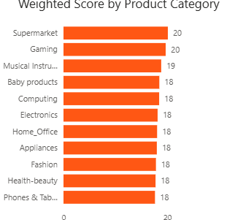
Weighted score by Product Category
Supermarket and Gaming categories have the highest weighted scores, showing strong customer engagement and satisfaction. Most other categories perform similarly, scoring just slightly lower. The score ranges from (18-20).

Slide 6
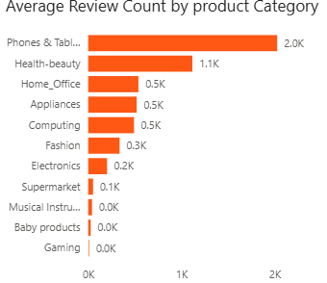
Average review by Product Category
Phones & Tablets show the highest customer engagement(2,025) then health-beauty (1,116) based on review count, while Gaming and Baby Products have the lowest.

Slide 7
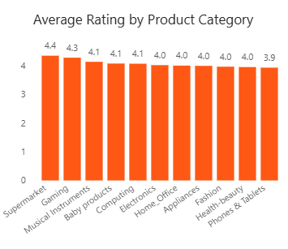
Average rating by Product Category
All product categories maintain a high average rating (3.94 – 4.36), showing strong customer satisfaction overall.
Supermarket has the highest customer satisfaction (4.36), while Phones & Tablets have the lowest (3.94).

Slide 8
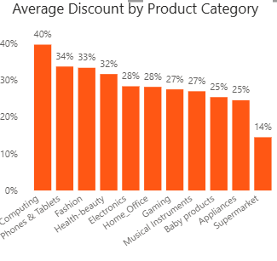
Average Discount by Product Category
Computing (40%) and Phones & Tablets (34%) have the highest average discounts, likely to attract buyers, clear inventory, or compete in crowded markets. Supermarket and Appliances have smaller discounts.

Slide 9
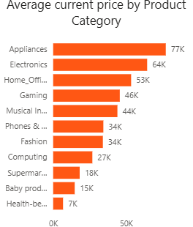
Average Current price by Product Category
This chart shows which product categories are generally more expensive based on their average listed (current) prices. Appliances have the highest average price, meaning they’re typically expensive items, while categories like Health & Beauty offer more affordable products.

Slide 10
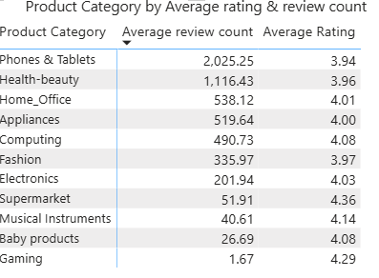
Product Category by Average Reviews & Ratings.
Phones & Tablets have the highest review count but the lowest ratings indicating high engagement but low customer satisfication.
Baby Products have a very low review count (26.69) but a good rating (4.08), suggesting low visibility but satisfied customers.
Supermarket has the highest average rating (4.36) but low engagement.

Slide 11
RECCOMENDATIONS
Focus on high performing categories like Appliances and electronics so as to offer opportunities.
Focus marketing on high- engagement categories for promotions. e.g Phone & tablets
Leverage discounts strategically to make more sales and use it to clear underperforming product.
Customer satisfaction for all products should be a top priority.

